Slide 1

LENDING CLUB CASE STUDY ASSIGNMENT SUBMISSION
Name: Chebrolu Bala Sai Harika & Vibhor Goyal

Slide 2
Abstract
This company is the largest online loan marketplace, facilitating personal loans, business loans, and financing of medical procedures. Borrowers can easily access lower interest rate loans through a fast-online interface.
The main objective is to understand the driving factors (or driver variables) behind loan default, i.e. the variables which are strong indicators of default. The company can utilize this knowledge for its portfolio and risk assessment.

Slide 3
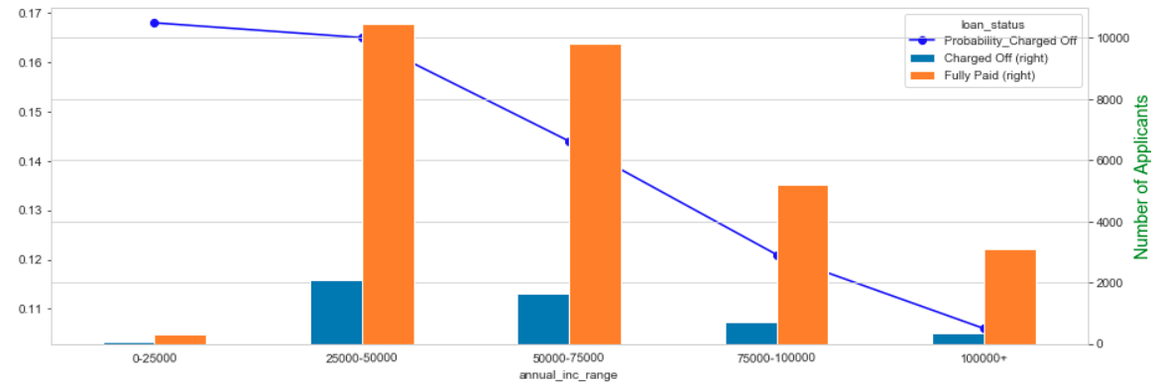
Annual Income Analysis
From above graph, we can infer that:
Number of applicants are more in the range of 25000-50000 annual income.
The probability of charged off decreases as the annual income of the applicant rises.

Slide 4
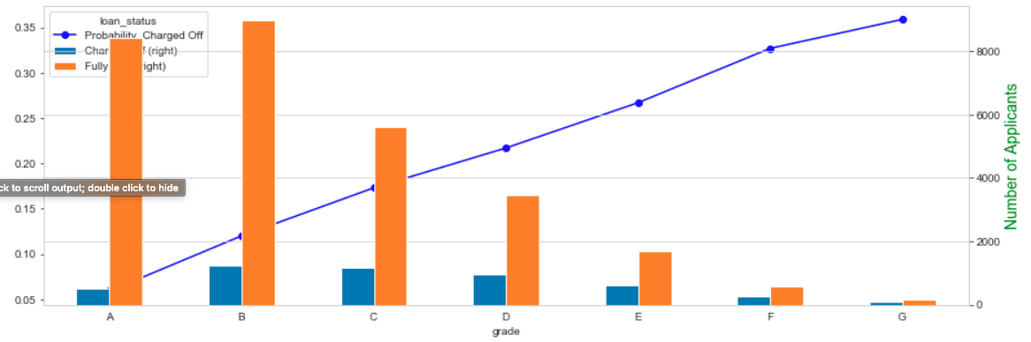
Grade Analysis
From the above graph, we can infer that:
The number of applicants are more in the A and B grade
The probability of charged off decreases as the grade rises.

Slide 5
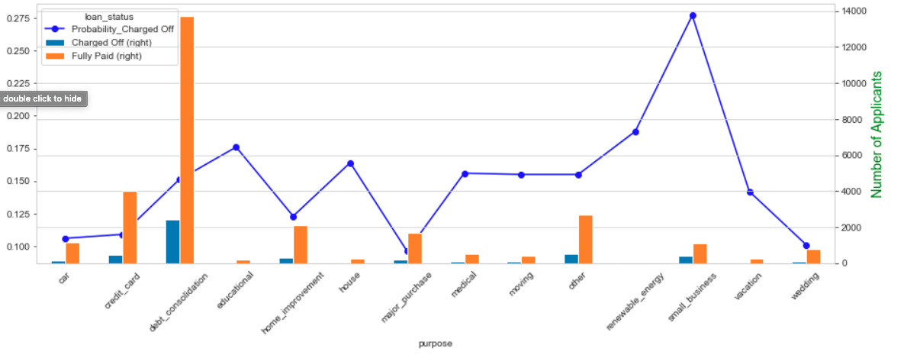
Purpose Analysis
From the above graph, we can infer that:
Small business applicants have more chances of being charged off

Slide 6
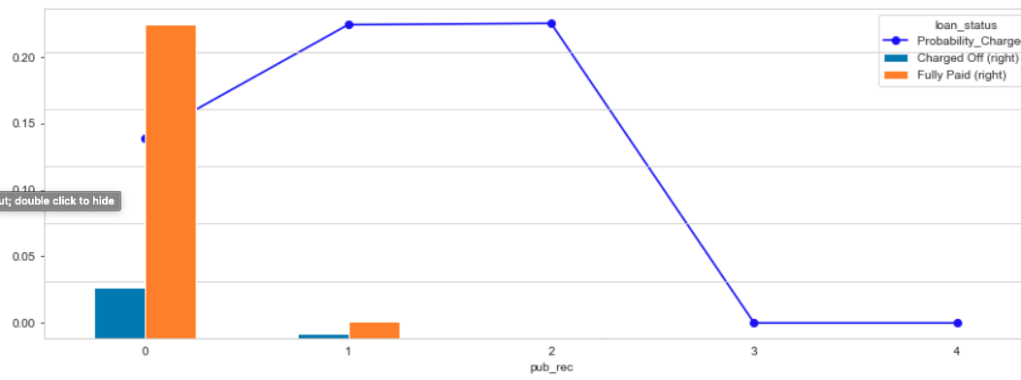
Derogatory Public Records Analysis
From the above graph, we can infer that:
The greatest number of applicants applied for the loan have 0 public derogatory accounts.
The applicants most likely to be charged off are the ones having 1 and 2 derogatory accounts.

Slide 7
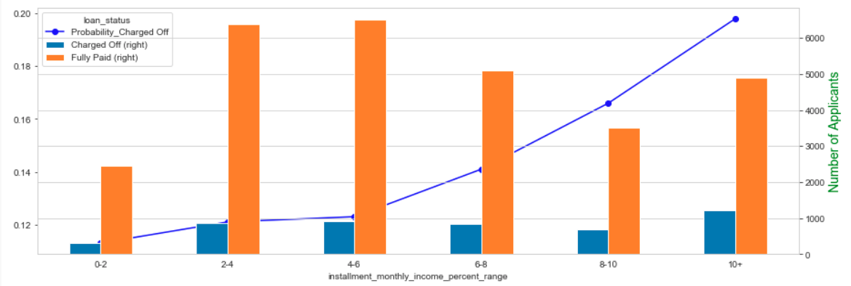
Installment/Income Analysis
From the above graph, we can infer that:
Most the people prefer to take loans with installment 2% to 6% of their monthly income.
With the rise in installment to income percent, the probability of charged off increases.

Slide 8
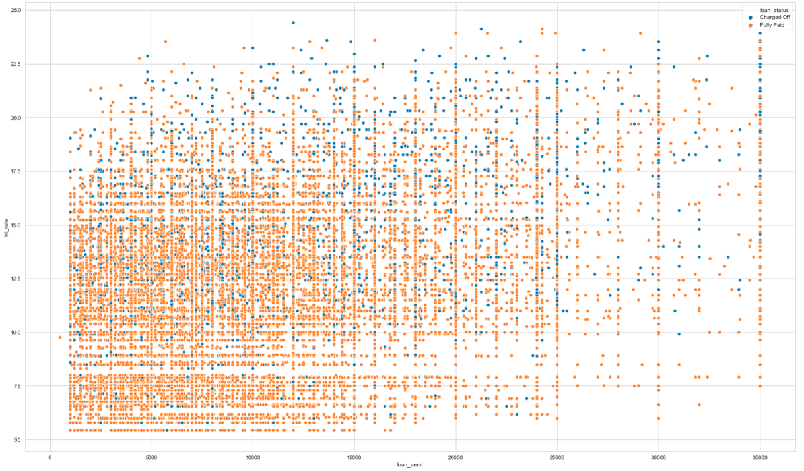
Loan Amount/ Interest Rate Analysis
From the above graph, we can infer that:
Most of the people who are Charged Off are the ones paying more than 10% interest rate.
We can also see that where loan amount is greater than 25000 and interest is less than 10%, there are very less chances of charged off.

Slide 9
Results
Bad Loans Count: People that apply for small business tend to have a higher risk.
Most frequent Purpose: More people applied loan to consolidate debt.
Less frequent purpose: More people applied loan to educational purposes.
Interest Rates: People with lower income had on average higher interest rates while people with higher annual income had lower interest rates on their loans. People having high income took higher loan amounts than people from low- and medium-income categories. Of course, people with higher annual incomes are more likely to pay loans with a higher amount.

Slide 10
Conclusion
Top-5 Major variables to consider for loan prediction:
Purpose of Loan => small business having more changes of charged off
Ratio of Instalment to Income is directly proportional to the chances of charged off
Grade is inversely proportional to the chances of charged off
Interest Rate is directly proportional to the chances of charged off
Number of derogatory public records has high changes of being charged off for value 1 and 2

